Slide 1
Arterial Anastomosis Around the shoulder joint
BY
DR. OJEWALE A.O

Slide 2
Outline
Osteology of the Scapula
Features & attachments
Osteology of the humerus
Features & attachments
Arterial anastomosis around the shoulder joint (Intro)
Scapular anastomosis
Anastomosis around the surgical neck
Applied Anatomy

Slide 3
OSTEOLOGY OF THE SCAPULA

Slide 4
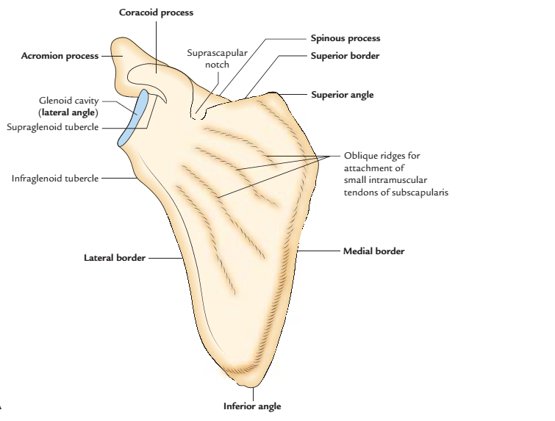
SCAPULA
The scapula (shoulder blade) is a large, flattened, and triangular bone located on the upper part of the posterolateral aspect of the thorax, against 2nd to 7th ribs.
PARTS
It is highly mobile and consists of four parts: a body and three processes:spinous, acromion, and coracoid.
Right scapula: A, anterior aspect

Slide 5
Body
The body is triangular, slender, and transparent. It presents the following features:
Two surfaces: (a) costal and (b) dorsal.
Three borders: (a) superior, (b) lateral, and (c) medial.
Three angles: (a) inferior, (b) superior, and (c) lateral.
The dorsal surface presents a shelf-like bony projection on its upper part called spinous process.
The lateral angle is condensed to form an articular surface-the glenoid cavity.

Slide 6
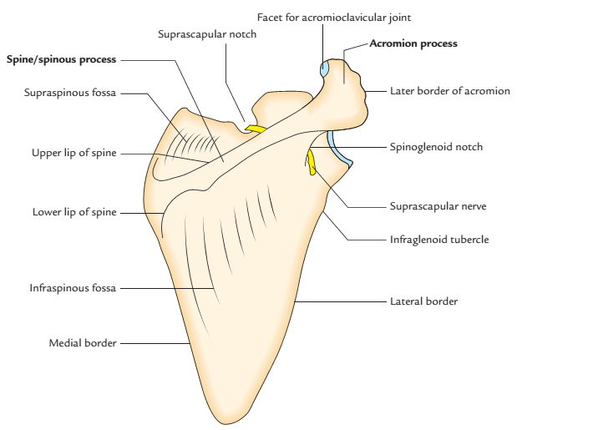
The lateral angle is thickened and called head of the scapula, which is connected to the plate-like body by an inconspicuous neck.
Right scapula: anterior aspect; posterior aspect.

Slide 7
Processes
There are three processes. These are as follows:
Spinous process.
Acromion process.
Coracoid process.
The spinous process is a shelf-like bony projection on the dorsal aspect of the body.
The acromion process projects forwards almost at right angle from the lateral end of the spine.
The coracoid process is like a bird’s beak. It arises from the upper border of the head and bends sharply to project superoanteriorly.

Slide 8
FEATURES AND ATTACHMENTS
Surfaces
Costal surface (subscapular fossa)
It is concave and directed medially and forwards.
It presents three longitudinal ridges, which provide attachment to the intramuscular tendons of subscapularis muscle.
The subscapularis muscle arises from the medial two-third of subscapular fossa/costal surface except near the neck where a subscapular bursa intervenes between the neck and the subscapular tendon.

Slide 9
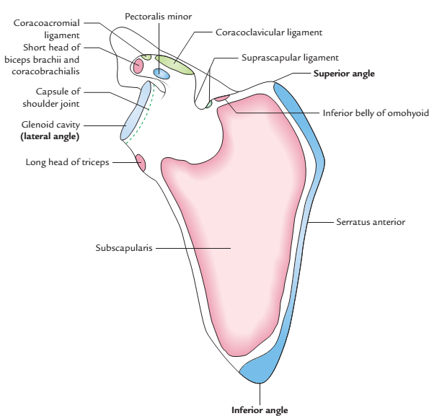
Cont’d
The serratus anterior muscle is inserted on this surface along the medial border and inferior angle.
Right scapula showing attachments of the muscles and ligaments:
costal surface.

Slide 10
Dorsal surface
The dorsal surface is convex and presents a shelf-like bony projection called spinous process.
The spinous process divides the dorsal surface into supraspinous and infraspinous fossae. The upper, supraspinous fossa is smaller (one-third) and lower, infraspinous fossa is larger (two-third).
The spinoglenoid notch lies between lateral border of the spinous process and the dorsal surface of the neck of scapula.

Slide 11
Through the spinoglenoid notch supraspinous fossa communicates with the infraspinous fossa and suprascapular nerve and vessels pass from supraspinous fossa to the infraspinous fossa.
The supraspinatus muscle arises from medial two-third of supraspinous fossa.
The infraspinatus muscle arises from medial two-third of infraspinous fossa.
The teres minor muscle arises from the upper two-third of the dorsal surface of lateral border. This origin is interrupted by the circumflex scapular artery.

Slide 12
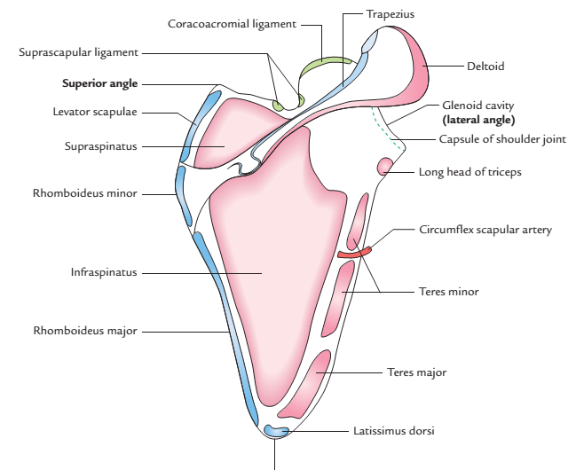
The teres major muscle arises from the lower one-third of the dorsal surface of lateral border and inferior angle of scapula.
The latissimus dorsi muscle also arises from dorsal surface of the inferior angle by a small slip.
Inferior angle
Right scapula showing attachments of the muscles
and ligaments: dorsal surface.

Slide 13
Borders
Superior border
The superior border is the shortest border and extends between superior and lateral angles.
The suprascapular notch is present on the superior border near the root of coracoid process.
The suprascapular notch is converted into suprascapular foramen by superior transverse (suprascapular) ligament.

Slide 14
Cont’d
The suprascapular artery passes above the ligament and suprascapular nerve passes below the ligament, through suprascapular foramen.
The inferior belly of omohyoid arises from the superior border near the suprascapular notch.

Slide 15
Lateral border
The lateral border is the thickest border, acts as fulcrum during rotation of the scapula and extends from glenoid cavity to the inferior angle .
The infraglenoid tubercle is present at its upper end, just below the glenoid cavity.
The long head of triceps muscle arises from the infraglenoid tubercle of the scapula.

Slide 16
Medial border (vertebral border)
It extends from superior angle to the inferior angle.
It is thin and angled at the root of spine of scapula.
The serratus anterior muscle is inserted on the costal surface of the medial border and the inferior angle.
The levator scapulae muscle is inserted on the dorsal aspect of the medial border from superior angle to the root of spine.

Slide 17
Cont’d
The rhomboid minor muscle is inserted on the dorsal aspect of the medial border opposite the root of spine.
The rhomboid major muscle is inserted on the dorsal aspect of the medial border from the root of spine to the inferior angle.

Slide 18
Angles
Inferior angle: It lies over the 7th rib or the 7th intercostal space.
Superior angle: It is at the junction of superior and medial borders, and lies over the 2nd rib.
Lateral angle (head of scapula)
It is truncated and bears a pear-shaped articular cavity called the glenoid cavity, which articulates with the head of humerus to form glenohumeral (shoulder) joint.
A fibrocartilaginous rim, the glenoid labrum is attached to the margins of glenoid cavity to deepen its concavity.

Slide 19
Cont’d
The capsule of shoulder joint is attached to the margins of glenoid cavity, proximal to the attachment of glenoid labrum.
The long head of biceps brachii arises from supraglenoid tubercle. This origin is intracapsular.

Slide 20
Processes
Spinous process (spine of scapula)
It is a triangular shelf-like bony projection, attached to the dorsal surface of scapula at the junction of its upper one-third and lower two-third.
It divides the dorsal surface of scapula into two parts-upper supraspinous fossa and lower infraspinous fossa.
The spine has two surfaces-(a) superior and (b) inferior, and three borders-(a) anterior, (b) posterior, and (c) lateral.

Slide 21
Surfaces
The superior surface of spine forms the lower boundary of supraspinous fossa and gives origin to supraspinatus muscle.
The inferior surface of spine forms the upper limit of infraspinous fossa and gives origin to infraspinatus muscle.

Slide 22
Borders
The anterior border of spine is attached to the dorsal surface of scapula.
The lateral border of spine bounds the spinoglenoid notch through which pass suprascapular nerve and vessels from supraspinous fossa to infraspinous fossa.
The posterior border of spine is also called crest of spine. Trapezius is inserted to the upper lip of crest of spine, while posterior fibres of deltoid take origin from its lower lip.

Slide 23
Acromion process (acromion)
It projects forwards almost at right angle from the lateral end of spine and overhangs the glenoid cavity.
It has a tip, two borders (medial and lateral), and two surfaces (superior and inferior).
The medial and lateral borders of acromion continue with the upper and lower lips of the crest of the spine of scapula, respectively.
Its superior surface is rough and subcutaneous.

Slide 24
Cont’d
Its inferior surface is smooth and related to subacromial bursa.
The medial border of acromion provides insertion to the trapezius muscle. Near the tip, medial border presents a circular facet, which articulates with the lateral end of clavicle to form the acromioclavicular joint.
The lateral border of acromion gives origin to intermediate fibres of the deltoid muscle.
The coracoacromial ligament is attached to the tip of acromion.

Slide 25
Cont’d
The acromial angle is at the junction of lateral border of acromion and lateral border of the crest of the spine of scapula.

Slide 26
Coracoid process
It arises from the upper part of the head of scapula and bent sharply so as to project forwards and slightly laterally.
The coracoid process provides attachment to three muscles-short head of biceps brachii, coracobrachialis, and pectoralis minor, and three ligaments-coracoacromial, coracoclavicular, and coracohumeral.

Slide 27
Cont’d
The short head of biceps brachii and coracobrachialis arise from its tip by a common tendon.
The pectoralis minor muscle is inserted on the medial border of the upper surface.
The coracoacromial ligament is attached to its lateral border.
The conoid part of the coracoclavicular ligament (rhomboid ligament) is attached to its knuckle.

Slide 28
Cont’d
The trapezoid part of the coracoclavicular ligament (rhomboid ligament) is attached to a ridge on its superior aspect between the pectoralis minor muscle and coracoacromial ligament.
The coracohumeral ligament is attached to its root adjacent to the glenoid cavity.

Slide 29
OSSIFICATION
The ossification of scapula is cartilaginous.
The cartilaginous scapula is ossified by eight centres-one primary and seven secondary.
The primary centre appears in the body.
The secondary centres appear as follows:
Two centres appear in the coracoid process.
Two centres appear in the acromion process.
One centre appears each in the (a) medial border, (b) inferior angle, and (c) in the lower part of the rim of glenoid cavity.

Slide 30
Cont’d
The primary centre in the body and first secondary centre in the coracoid process appears in eighth week of intrauterine life (IUL) and first year of postnatal life, respectively and they fuse at the age of 15 years.
All other secondary centres appear at about puberty and fuse by 20th year.

Slide 31
OSTEOLOGY OF THE HUMERUS

Slide 32
HUMERUS
The humerus is a long bone and consists of three parts: upper end, lower end, and shaft.
Upper End
The upper end presents the following five features:
Head.
Neck.
Greater tubercle.
Lesser tubercle.
Intertubercular sulcus

Slide 33
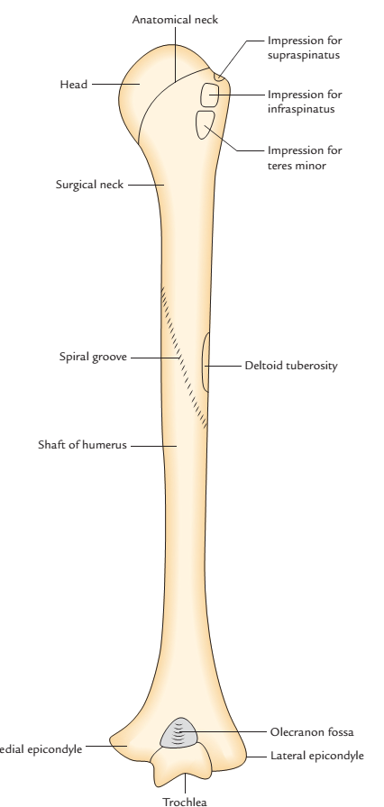
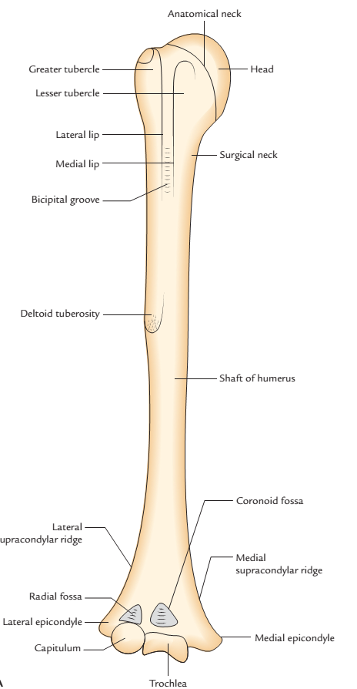
Right humerus: anterior view; posterior view

Slide 34
Cont’d
The head is smooth and rounded, and forms less than half of a sphere. It is directed medially backwards and upwards.
It articulates with the glenoid cavity of scapula to form the glenohumeral (shoulder) joint.

Slide 35
Lower End
The lower end presents the following features:
Capitulum,a lateral rounded convex projection.
Trochlea, a medial pulley-shaped structure.
Radial fossa, a small fossa above the capitulum.
Coronoid fossa, a small fossa above the trochlea.
Medial epicondyle, a prominent projection on the medial side.
Lateral epicondyle, a prominent projection on the lateral side but less than the medial epicondyle.
.

Slide 36
Neck of the humerus
The humerus has three necks:
Anatomical neck
It is constriction at the margins of the rounded head.
It provides attachment to the capsular ligament of the shoulder joint, except-superiorly where the capsule is deficient, for the passage of tendon of long head of biceps brachii, medially the capsule extends down from the anatomical neck to the shaft for about 1–2 cm.

Slide 37
Cont’d
Olecranon fossa, a large, deep hollow on the posterior aspect above the trochlea.
Shaft
The shaft is a long part of bone extending between its upper and lower ends. It is cylindrical in the upper half and flattened anteroposteriorly in the lower half.

Slide 38
FEATURES AND ATTACHMENTS
Upper End Head
It is smooth, rounded and forms one-third of a sphere.
It is covered by an articular hyaline cartilage, which is thicker in the center and thinner at the periphery.

Slide 39
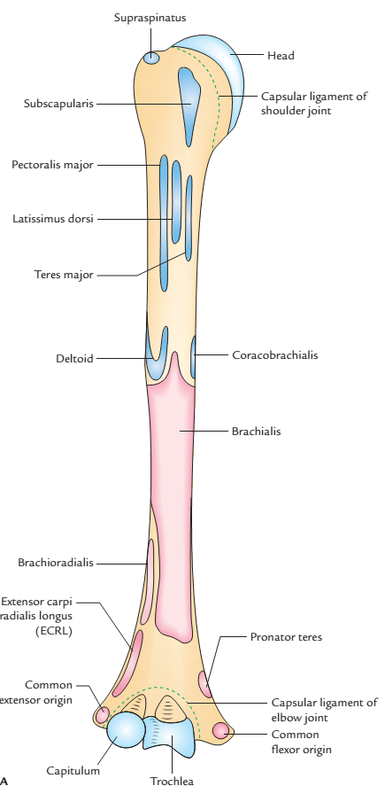
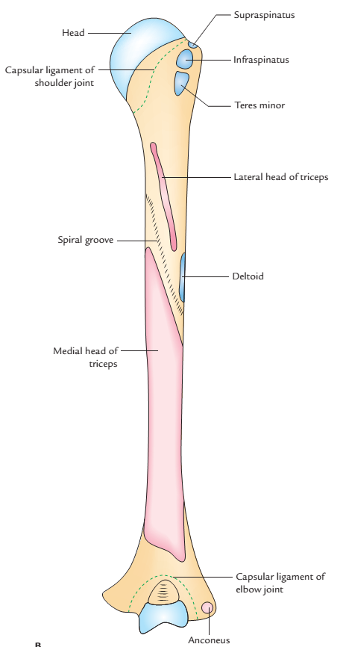
Right humerus showing attachments of the muscles and ligaments:
A, anterior aspect; B, posterior aspect

Slide 40
Surgical neck
It is short constriction in the upper end of the shaft below the greater and lesser tubercles/below the epiphyseal line.
It is related to axillary nerve and posterior and anterior circumflex humeral vessels.
It is the most important feature of the proximal end of the humerus because it is weaker than the more proximal regions of the bone, hence it is one of sites where the humerus commonly fractures leading to damage of associated nerves and vessels.

Slide 41
Greater tubercle
It is the most lateral part of the proximal end of humerus.
Its posterosuperior aspect bears three flattened facet-like impressions: upper, middle, and lower, which provide attachment to supraspinatus, infraspinatus, and teres minor muscles, respectively.
Lesser tubercle
It is small elevation on the front of upper end of humerus, just above the surgical neck.
It provides attachment to subscapularis muscle

Slide 42
Intertubercular Sulcus/Bicipital Groove
It is a vertical groove between lesser and greater tubercles.
It contains (a) long head of biceps, enclosed in the synovial sheath and (b) ascending branch of anterior circumflex humeral artery.
Three muscles are attached in the region of this groove:
Pectoralis major on the lateral lip of the groove.
Teres major on the medial lip of the groove.
Latissimus dorsi in the floor of the groove

Slide 43
Arterial Anastomosis Around the shoulder joint

Slide 44
Introduction
Anastomosis is the communication between the neighbouring vessels.
Circulation through anastomosis is called Collateral circulation.

Slide 45
Anastomosis around the shoulder joint
There are two anastomosis around the shoulder joint.
The Scapular anastomosis
Anastomosis around the surgical neck of humerus

Slide 46
Introduction
The scapular anastomosis occurs in three fossa; subscapular, supraspinous and infraspinous
The arterial anastomosis around scapula is principally formed between the branches of the first part of the subclavian and the third part of the axillary arteries.
The scapular anastomosis takes place at two sites: around the body of scapula and over the acromion process of the scapula.

Slide 47
SUBCLAVIAN ARTERIES
The subclavian artery is located beneath the clavicle. It is the main source of blood supply to the upper limb. It is also supplies considerable part of the thoracic wall, head, neck, and brain through its branches.
In the neck, both the arteries pursue a similar course. On each side, the subclavian artery arches laterally across the anterior surface of the cervical pleura onto the first rib posterior to the scalenus anterior muscle. At the outer border of 1st rib, it ends by becoming axillary artery.

Slide 48
Branches of the Subclavian Artery
The subclavian artery usually gives off four branches. All of them arise from first part with the exception of costocervical trunk, which on the right side arises from the second part.
The first part:
Vertebral artery
Thyrocervical trunk
a. Inferior thyroid artery
b. Transverse cervical artery
Suprascapular artery
Internal thoracic artery
Costocervical trunk (on left side only)

Slide 49
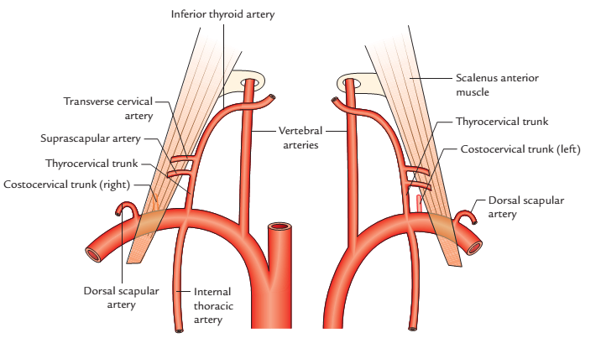
Branches of the right and left subclavian arteries

Slide 50
Parts of the subclavian artery
On each side, the subclavian artery is divided into three parts by the scalenus anterior muscle
These are:
First part: It extends from origin to medial border of scalenus anterior.
Second part: It lies behind the scalenus anterior muscle.
Third part: It extends from the lateral border of scalenus anterior to the outer border of the first rib.

Slide 51
The second part:
Costocervical trunk (on right side only).
The third part:
Dorsal scapula artery: It is an occasional branch that may arise from the third part of the subclavian artery. When present, it replaces the deep branch of the transverse cervical artery.

Slide 52
Cont’d
Around the body of scapula:
It occurs between the suprascapular artery, a branch of the thyrocervical trunk from the first part of the subclavian artery.
Deep branch of the transverse cervical artery, a branch of the thyrocervical trunk.
Circumflex scapular artery, a branch of the subscapular artery from the third part of the axillary artery.

Slide 53
Cont’d
Over the acromion process: It occurs between the
Acromial branch of the thoraco-acromial artery
Acromial branch of the suprascapular artery
Acromial branch of the posterior circumflex humeral artery.

Slide 54
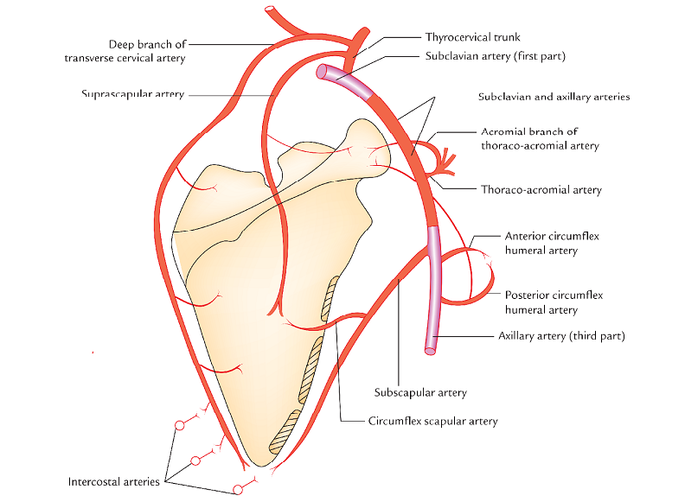
Scapular anastomosis

Slide 55
Anastomosis around the Surgical Neck of humerus
It occurs just below the surgical neck of humerus
It between the branches of 3rd part of axillary artery.
The branches involved:
Anterior circumflex humeral artery
Posterior circumflex humeral artery

Slide 56
APPLIED ANATOMY
Collateral circulation through scapular anastomosis: If the subclavian and axillary arteries are blocked anywhere between 1st part of subclavian artery and 3rd part of axillary artery, It serves as a potential pathway (collateral circulation) between the first part of the subclavian artery and the third part of the axillary artery, to ensure the adequate circulation to the upper limb.

Slide 57


